Slide 1
Infrastructure Management
Phalachandra HL
Acknowledgements:
Significant portions of the information in the slide sets presented through the course in the class are extracted from IT Systems Management -Rich Schiesser and other books/Internet. Since these were intended for presentation in the class room for teaching, instructor resources has been requested from the publisher, but not received yet. I would like to sincerely thank, acknowledge and reiterate that the credit/rights remain with the original authors/publishers only

Slide 2
Introduction
Session 1

Slide 3
In the course
IT Infrastructure, IT infrastructure Mgmt, Challenges, Support needed by executives (Business Case) and then designing and structuring the IT Organization, Process owners and responsibility of Process owners
The need for staffing and retaining people with required skills and skill levels, the personal and business ethics or lack of it and it’s impact in-terms of legislation and what that drives into organizations
Evolution of the IT Systems management as customer services and the approach of sharing of the best practices with ITIL
There are 12 key processes used in IT Systems management which would be discussed as part of the course
Availability Management
Performance/Tuning
Production Acceptance
Change Management
Problem Management
Storage Management
How would you build world class processes and integrating the processes described above
Network Management
Configuration Management
Capacity Planning
Security
Business Continuity
Facilities Management

Slide 4
What is primary role of IM
Support business with high quality.

Slide 5
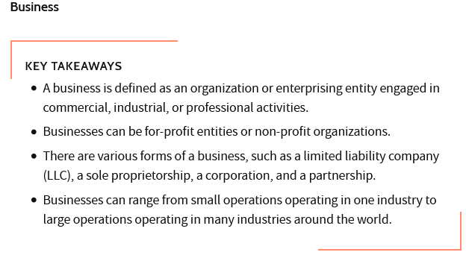
What is Business

Slide 6
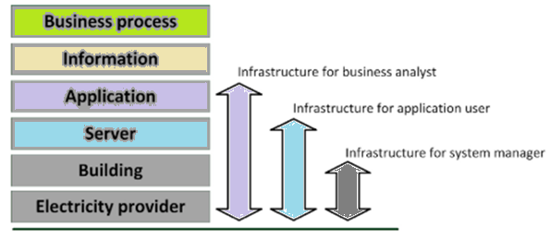
IT Infrastructure
Defn:
IT infrastructure consists of equipment, systems, software and services, used in common across an organization, that are required to develop, test, deliver, monitor, control or support IT Services to customers regardless of mission/program/project
Different Views of IT Infrastructure

Slide 7
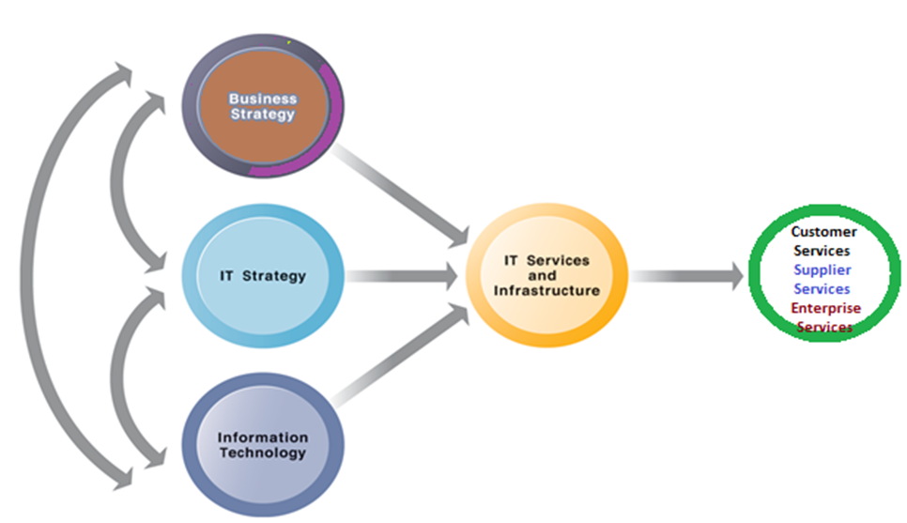
Organization and its IT Infrastructure
IT Services and processes enable the organization in the “creation”, “management” and “optimization of” or “access to” Information and Business Processes using Business and Technical expertise.
The Services a firm is capable of providing to its customers, suppliers, and employees is a function of its IT infrastructure.
IT infrastructure should support the firm’s business and information systems strategy.
Information Technology Infrastructure
Relationship between an Organization, Business Capabilities and its IT Infrastructure

Slide 8
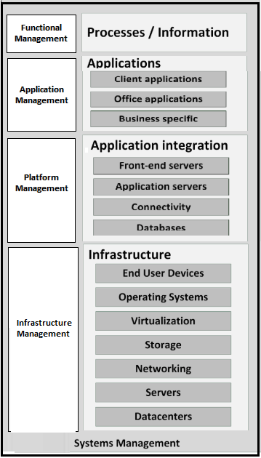
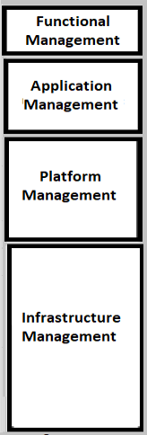
IT Infrastructure Systems Management
Systems Management:
Is the activity of identifying and integrating various products and processes in order to provide a stable and responsive IT environment
It also involves setting up of policies for the IT environment and providing tools and information for the IT services management

Slide 9
Objectives of IT Infrastructure Systems Management
IT Infrastructure typically consists of number of Physical devices right from
Servers
Disk storage
and other software products, which are required for running the “Applications” needed for functioning of the Enterprise.
This infrastructure needs to
Provide stable (and Available) and responsive IT infrastructure
Stability : Systems are always up and accessible as scheduled 24x7
: Measure : % of uptime, % of Down time, MTBF and MTTR
Responsiveness : How quickly the jobs can be processed and completed
: Throughput, Avg TAT
Predictable support and service costs that scales with business
Reduction of cost of IT Management
Increased flexibility and responsiveness to business needs (agile)
Improved productivity and customer satisfaction
Improved security, reliability and availability of IT infrastructure
Ability to integrate existing technologies and add new technologies
Networks
Desktop computers
Databases

Slide 10
Objectives of IT Infrastructure Systems Management
Developing organizational capabilities to efficiently and effectively manage enterprise IT is what ITSM is all about and is an essential component of IT transformation story
This stable and responsive IT environment, is provided by the Infrastructure using a set of products, services or processes
There are 12 key processes used in IT Systems management which would be discussed as part of the course
Availability Management
Performance/Tuning
Production Acceptance
Change Management
Problem Management
Storage Management
Network Management
Configuration Management
Capacity Planning
Security
Business Continuity
Facilities Management

Slide 11
IT Infrastructure Systems Management Challenges
Scale
Physical Expansion
Capacity Planning
Diversity of an IT Plant
Focus on uniform components (H/W and S/W)
Vendor Locking
H/W and S/W lifecycle Management
Custom Solutions
Deployment and OS Build
OS and Configuration Diversity/Hygiene
Support Personnel
High Availability/Resiliency
Special H/W (trader desktops)
Environment, Power saving

Slide 12
IT Infrastructure Management
Executive Support
IT infrastructure management will need Executive support in terms of
IT Budget and Resources
Contemporary data centers need significant resources as they have to handle availability, provide online response times, support storage management, capacity planning, change management, problem management, and disaster recovery
Air-support
Infrastructure support groups will need to support technical issues and requests from a technical user community, who are more demanding
Mindshare
Relating to and being empathetic to the requirements and importance of a well-implemented infrastructure

Slide 13
IT Infrastructure Management
Executive Support : Business Case a means of soliciting support
Focus of CIOs typically is towards application of cost effective technology, rather than on the technology itself.
A Business case is a clear and succinct cost justification for funds for IT Infrastructure management
An effective and thorough business case will itemize all of the associated costs of a new system or process and compare it to the expected benefits.
Challenge:
It is often very difficult to predict accurately the true benefits of a new system or process. Even when the estimated benefits are reasonably accurate, its very hard to put a $ figure for the same as some of the benefits could be qualitative rather than quantitative

Slide 14
IT Infrastructure Management
Executive Support : Building a Business Case
Steps for Developing a business case for a systems management function:
Understanding which IT business goals are most critical to achieve the company’s Business goals. (Alignment)
Determining which systems management functions are most critical to meeting the IT business goals at that point of time. (Selection)
E.g. Focusing on scalability would be more beneficial when the provisioned capacity is crossing an identified critical level rather than during startup when capacity is not a constraint
Awareness that these could change over time as the goals of the company changes
Meeting and conferring with IT senior management to confirm and prioritize the systems management functions to be focused on. (Validation)

Slide 15
IT Infrastructure Management
Executive Support : Building a Business Case
Steps for Developing a business case for a systems management function (Contd.)
Estimating all costs associated with the implementation and maintenance of a particular function.
Cost of software licenses
Procurement
Enhancement
Maintenance
Cost of Manpower
Recruiting
Training
Itemizing all benefits associated with the function.
Being able to predict capacity shortages before they occur
Reducing the frequency and duration of outages and hence the un-productive time
Increasing productivity by improving response times
Ensuring business continuity during disaster recovery
Avoiding the cost of rebuilding databases and reissuing transactions
Cost of Hardware
Procurement
Hardware upgrades
Hardware maintenance
Office space
Scheduled outages

Slide 16
IT Infrastructure Management
Executive Support : Building a Business Case
Steps for Developing a business case for an systems management function (Contd.)
Converting benefits to dollar savings to the extent possible.
Building credibility to the proposed Business case by Soliciting testimonials from customers of other similar companies and demonstrating real-life benefits of a product in an actual business setting
Presenting the same in the Business terms as would be related by the Executive audience with the technical knowledge supporting it

Slide 17


IT Infrastructure Management
Executive Support : Presenting a Business Case
Three Universal Principles Involving Executive Support
Managers love alternatives.
Primary responsibility of managers is to evaluate alternatives and make a decision of an alternative for the current scenario.
Presenting viable alternatives say for infrastructure decisions in terms of products, vendors, platforms, levels of support, time of implementations, ways of procurement, deployment etc. supports and eases the process of decision making.
Managers hate surprises.
Managers do not like to be blindsided by business surprises, such as hidden costs, unpredicted delays, or unscheduled outages or unplanned dependencies and limitations. Risks can be mitigated with contingency plans, but surprises are not welcome.
Notes:
.

Slide 18

IT Infrastructure Management
Executive Support : Presenting a Business Case
Three Universal Principles Involving Executive Support (Contd.)
Managers like metrics.
Metrics make decisions to be more data based and deterministic. So metrics can be a persuasive tool for obtaining Executive support
Most CIOs depend on a small number of meaning-full metrics which demonstrates the business value of a decision E.g. In a banking system using no of transactions which is processed/sec (response time)
Understanding the Business environment and then developing a few meaningful metrics which reflects the Business will help in getting executive support
Sustained ongoing Executive support needs positive reinforcements like the improvements in the Business processes over a period of time presented as charts graphs or tables
Staying informed of the strategies of Business & trends of the enterprise, and keeping the Executives appraised on the synergistic strategies & trends of IT, will support sustained ongoing support for the System management disciplines

Slide 19
Once Executive Support is obtained focus shifts to structuring and effectively organizing

Slide 20
IT Infrastructure Management
Organizing the IT infrastructure for Systems Management
Organizing an organization or a group, supports coordination of work through a structured hierarchy and business processes. It also has the culture embedded with it.
IT departments, which are responsible for the IT Infrastructure needs to be organized for Optimal efficiencies and effectiveness of the system management processes.
Organization structure can be looked at as the way in which IT organization arranges its tasks, people and techniques.
This arrangement builds in relationships between the different departments (and its members) and assigns roles and responsibilities and authority to carry out different activities.
Typically there exists a leader responsible and multiple (layer’s of) subordinates.
There are different alternative approaches/scenarios of structuring the various groups that comprise the IT infrastructure. These could be Functional, Divisional, Matrix, Flat

Slide 21
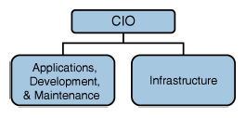
IT Infrastructure Management
Organizing the IT infrastructure for Systems Management
Key factors which could be considered for Designing the IT organizations
Departmental Responsibilities (Work specializations and Functionality)
Planning Orientation
Infrastructure processes
Chain of Command (reporting structure) and Span of Control (Capacity)
[Need to also consider centralization and decentralization of decision making]
In most times, higher the position of a process/function/ group in the organization structure, higher is its effectiveness, visibility and stature
Organizations will and should evolve as the Business evolves
A Basic IT Organization

Slide 22
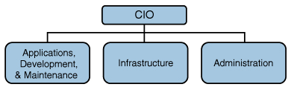
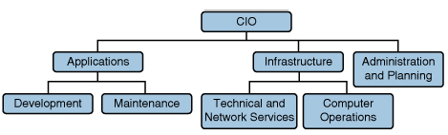
IT Infrastructure Management
Organizing the IT infrastructure for Systems Management
IT Organization with a separate Administration department - as the company evolves
Billing, Invoices, Asset Management, procurement, HR and a few tactical responsibilities
IT Organization with all the three groups evolving further as below
Split into functions as part of Application, Splitting of Infrastructure to Network/Tech services and operations, Addition of Strategic planning to Administration

Slide 23
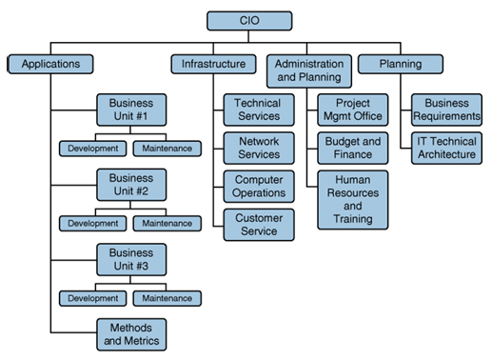
IT Infrastructure Management
Organizing the IT infrastructure for Systems Management
IT Organization evolving still further to Business Units, Different technical Services, Project Management, Budgeting and HR … (combination of functional and divisional)

Slide 24
IT Infrastructure Management
Designing the IT infrastructure for Systems Management
Factors to Consider in Designing IT Infrastructures
Size of the organization
Maturity of the organization (is it a startup or the duration of its existence)
Orientation of the firm and its IT organization
Combining Voice and Data groups
Consider IT-wide functions like Security, Planning, Quality Assurance, Procurement, Asset management to be with in the Infrastructure organization or to be independent of it
Location of Departments in the Infrastructure Organizations E.g. Location of Service Desk
Since Service Desk is the first point of contact for users with the IT organization and will have a lasting impression on the quality, hence positioning it higher in the Organization can increase its effectiveness, visibility and stature Positioning.

Slide 25
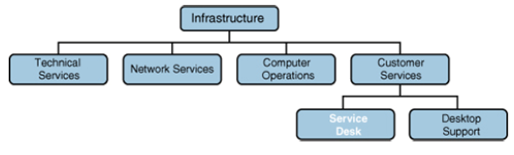
IT Infrastructure Management
Designing the IT infrastructure for Systems Management
Location of Departments in the Infrastructure Organizations (Contd.)
Location of Service Desk (Contd.)
Some of the practices like number of rings before response, response by a machine to a human agent, agents' attitude, time and determinateness of the response and follow-up to closure
The number of Service Desks (could be a factor of the Maturity of the organization), consolidated or otherwise and how they interface with say the support group and other peer support groups.
Service
Desk

Slide 26
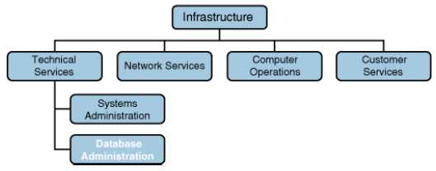
IT Infrastructure Management
Designing the IT infrastructure for Systems Management
Location of Departments in the Infrastructure Organizations (Contd.)
Location of Database Administration
Should this be a part of Application development group, as DB structure & design is closely linked to Application requirements & development
Should this be part of technical services infrastructure group as majority of the activities beyond the design is with performance and tuning
Combination of design being with the application design and post design as part of services
or
or
Database Administration
Database Administration

Slide 27
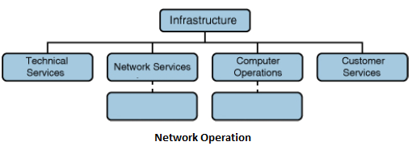

IT Infrastructure Management
Designing the IT infrastructure for Systems Management
Location of Departments in the Infrastructure Organizations
Location of Network Operations
Location of Systems Management
Systems management: ~12 services like Change Management, problem Management, configuration management, capacity management, storage management, security management, Disaster recovery
Systems
Management

Slide 28
IT Infrastructure Management
Responsibilities of Process Owners
Having the right process owner is one of the critical factors in the implementation of the systems management processes. This role will need to lead
Assembling of the cross-functional design team;
Implementing of the agreed-upon process;
Communication of all appropriate parties;
Developing and maintaining the process’s documentation;
For establishing and reporting on its metrics; and,
Depending on the specific process involved, for administering other support tasks such as
Chairing change review boards or
Compiling user-workload forecasts.

Slide 29
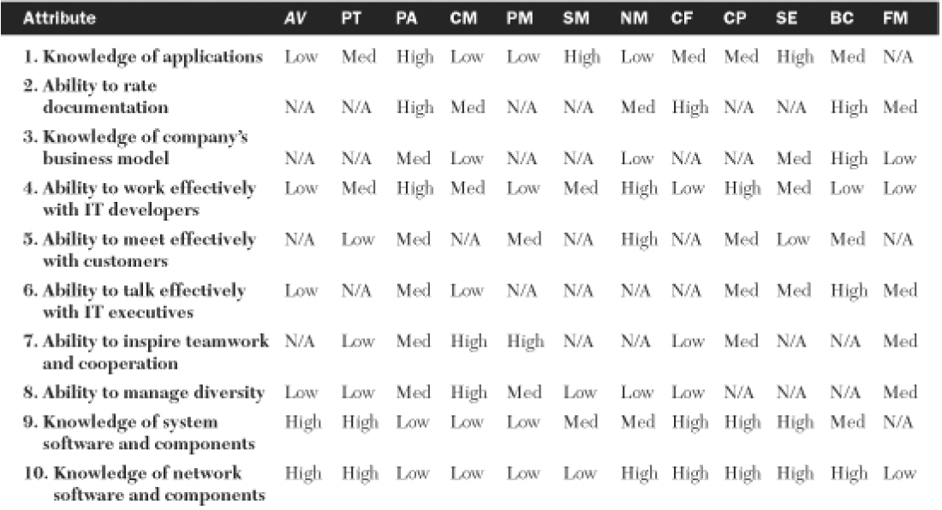
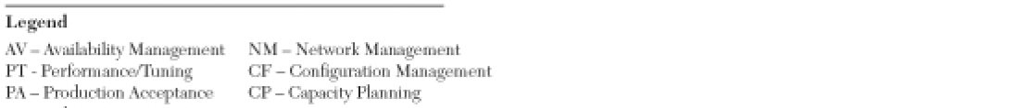

IT Infrastructure Management
Recommended Attributes for Process Owners

Slide 30
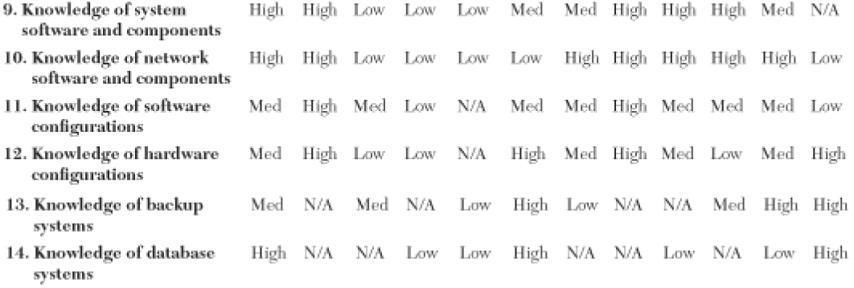
IT Infrastructure Management
Recommended Attributes for Process Owners

Slide 31
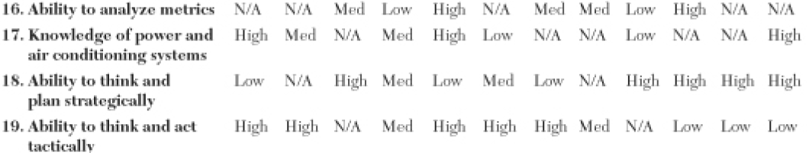

IT Infrastructure Management
Recommended Attributes for Process Owners

